Slide 1
Google file systems
Hadoop distributed file systems

Slide 2
File System
GFS, HDFS
Programming Model
MapReduce, Pregel
Storage System for Structured Data
Bigtable, Hbase

Slide 3
Google vs. Hadoop
Develop Group | Google | Apache
Sponsor | Google | Yahoo, Amazon
Resource | open document | open source
File System | GFS | HDFS
Programming Model | MapReduce | Hadoop MapReduce
Storage System (for structure data) | Bigtable | Hbase
Search Engine | Google | Nutch
OS | Linux | Linux / GPL

Slide 4
Distributed File Systems
Allows access to files from multiple hosts sharing via a computer network
Must support concurrency
Make varying guarantees about locking, who “wins” with concurrent writes, etc...
Must gracefully handle dropped connections
May include facilities for transparent replication and fault tolerance
Different implementations sit in different places on complexity/feature scale

Slide 5
Google File System
How to process large data sets and easily utilize the resources of a large distributed system …

Slide 6
Motivations
Fault-tolerance and auto-recovery need to be built into the system.
Standard I/O assumptions (e.g. block size) have to be re-examined.
Record appends are the prevalent form of writing.
Google applications and GFS should be co-designed.

Slide 7
Roles in GFS
Roles: master, chunkserver, client
Commodity Linux box, user level server processes
Client and chunkserver can run on the same box
Master holds metadata
Chunkservers hold data
Client produces/consumes data

Slide 8
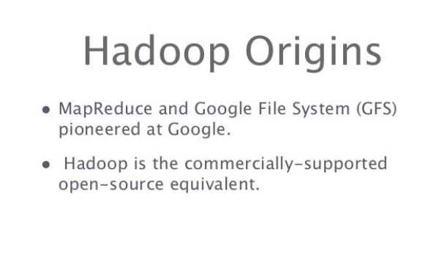
hadoop

Slide 9
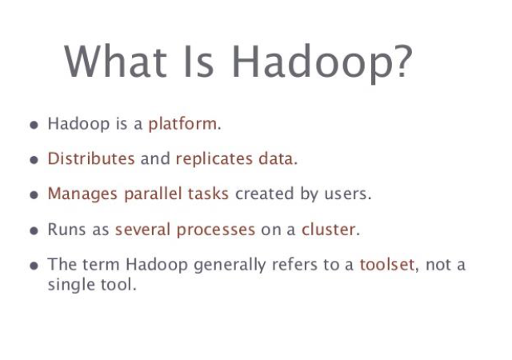
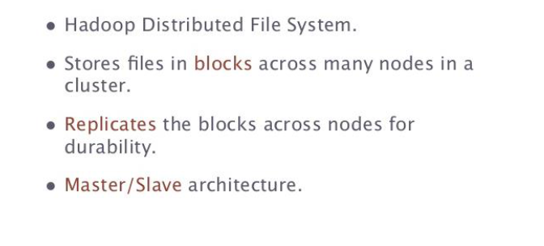
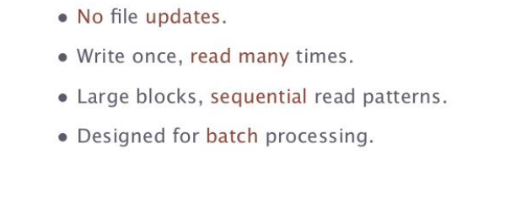

Slide 10
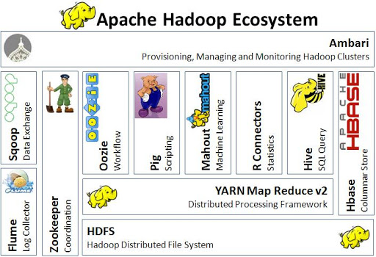

Slide 11
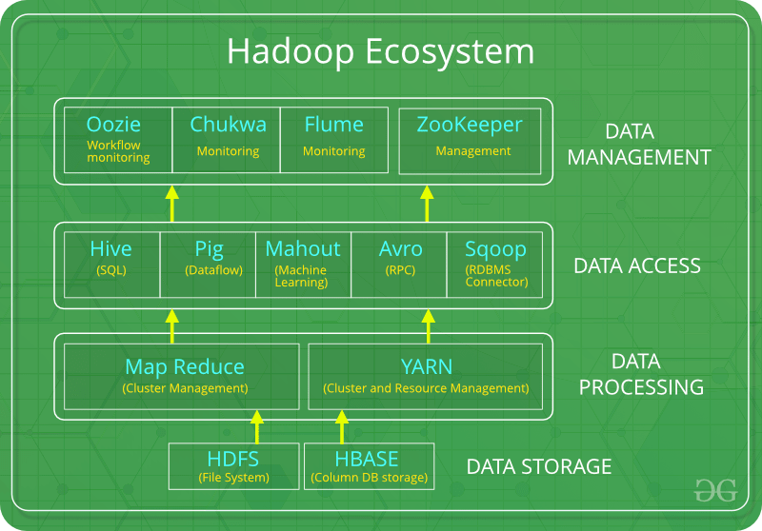
Hadoop Ecosystems

Slide 12
components that collectively form a Hadoop ecosystem
HDFS: Hadoop Distributed File System
YARN: Yet Another Resource Negotiator
MapReduce: Programming based Data Processing
Spark: In-Memory data processing
PIG, HIVE: Query based processing of data services
HBase: NoSQL Database
Mahout, Spark MLLib: Machine Learning algorithm libraries
Solar, Lucene: Searching and Indexing
Zookeeper: Managing cluster
Oozie: Job Scheduling

Slide 13
HDFS:
HDFS is the primary or major component of Hadoop ecosystem and is responsible for storing large data sets of structured or unstructured data across various nodes and thereby maintaining the metadata in the form of log files.
HDFS consists of two core components i.e.
Name node
Data Node
Name Node is the prime node which contains metadata (data about data) requiring comparatively fewer resources than the data nodes that stores the actual data. These data nodes are commodity hardware in the distributed environment. Undoubtedly, making Hadoop cost effective.
HDFS maintains all the coordination between the clusters and hardware, thus working at the heart of the system.

Slide 14
YARN:
Yet Another Resource Negotiator, as the name implies, YARN is the one who helps to manage the resources across the clusters. In short, it performs scheduling and resource allocation for the Hadoop System.

Slide 15
Consists of three major components i.e.
Resource Manager
Nodes Manager
Application Manager
Resource manager has the privilege of allocating resources for the applications in a system whereas Node managers work on the allocation of resources such as CPU, memory, bandwidth per machine and later on acknowledges the resource manager. Application manager works as an interface between the resource manager and node manager and performs negotiations as per the requirement of the two.

Slide 16
MapReduce:
By making the use of distributed and parallel algorithms, MapReduce makes it possible to carry over the processing’s logic and helps to write applications which transform big data sets into a manageable one.

Slide 17
MapReduce makes the use of two functions i.e. Map() and Reduce() whose task is:
Map() performs sorting and filtering of data and thereby organizing them in the form of group. Map generates a key-value pair based result which is later on processed by the Reduce() method.
Reduce(), as the name suggests does the summarization by aggregating the mapped data. In simple, Reduce() takes the output generated by Map() as input and combines those tuples into smaller set of tuples.

Slide 18
PIG:
Pig was basically developed by Yahoo which works on a pig Latin language, which is Query based language similar to SQL.
It is a platform for structuring the data flow, processing and analyzing huge data sets.
Pig does the work of executing commands and in the background, all the activities of MapReduce are taken care of. After the processing, pig stores the result in HDFS.
Pig Latin language is specially designed for this framework which runs on Pig Runtime. Just the way Java runs on the JVM.
Pig helps to achieve ease of programming and optimization and hence is a major segment of the Hadoop Ecosystem.

Slide 19
HIVE:
With the help of SQL methodology and interface, HIVE performs reading and writing of large data sets. However, its query language is called as HQL (Hive Query Language).
It is highly scalable as it allows real-time processing and batch processing both. Also, all the SQL datatypes are supported by Hive thus, making the query processing easier.
Similar to the Query Processing frameworks, HIVE too comes with two components: JDBC Drivers and HIVE Command Line.
JDBC, along with ODBC drivers work on establishing the data storage permissions and connection whereas HIVE Command line helps in the processing of queries.

Slide 20
Mahout:
Mahout, allows Machine Learnability to a system or application. Machine Learning, as the name suggests helps the system to develop itself based on some patterns, user/environmental interaction or on the basis of algorithms.
It provides various libraries or functionalities such as collaborative filtering, clustering, and classification which are nothing but concepts of Machine learning. It allows invoking algorithms as per our need with the help of its own libraries.

Slide 21
Apache Spark:
It’s a platform that handles all the process consumptive tasks like batch processing, interactive or iterative real-time processing, graph conversions, and visualization, etc.
It consumes in memory resources hence, thus being faster than the prior in terms of optimization.
Spark is best suited for real-time data whereas Hadoop is best suited for structured data or batch processing, hence both are used in most of the companies interchangeably.

Slide 22
Apache HBase:
It’s a NoSQL database which supports all kinds of data and thus capable of handling anything of Hadoop Database. It provides capabilities of Google’s BigTable, thus able to work on Big Data sets effectively.
At times where we need to search or retrieve the occurrences of something small in a huge database, the request must be processed within a short quick span of time. At such times, HBase comes handy as it gives us a tolerant way of storing limited data

Slide 23
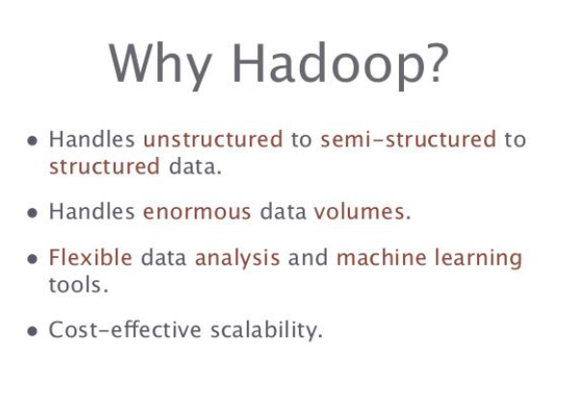

Slide 24
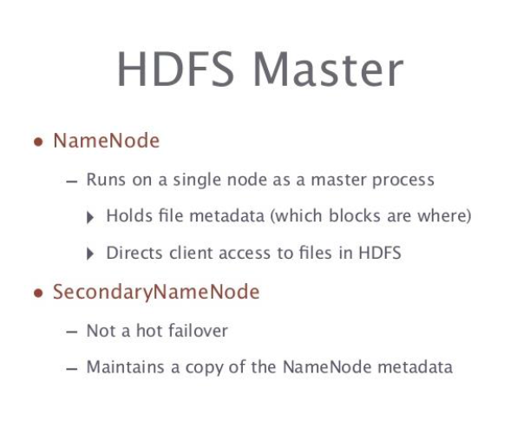

Slide 25
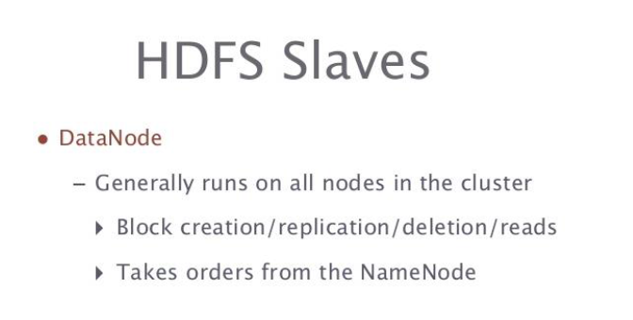

Slide 26
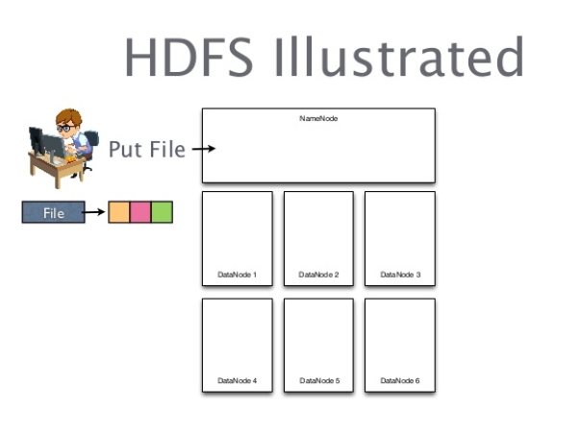
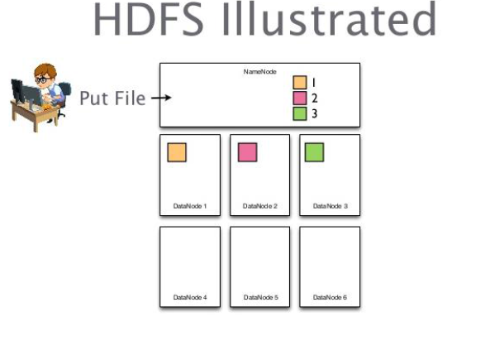

Slide 27
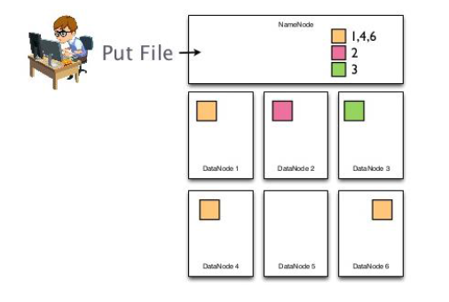
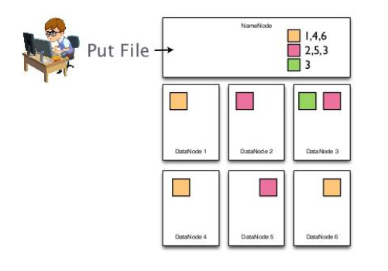
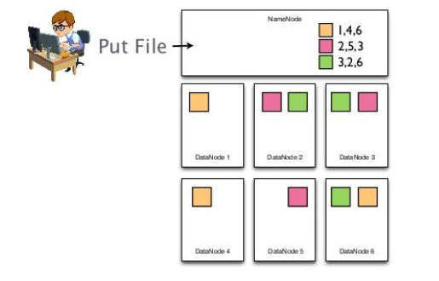

Slide 28
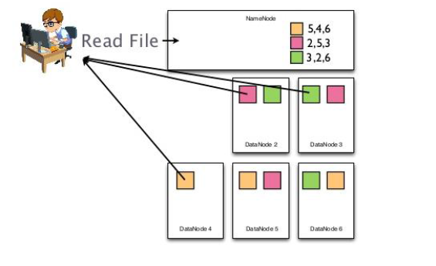
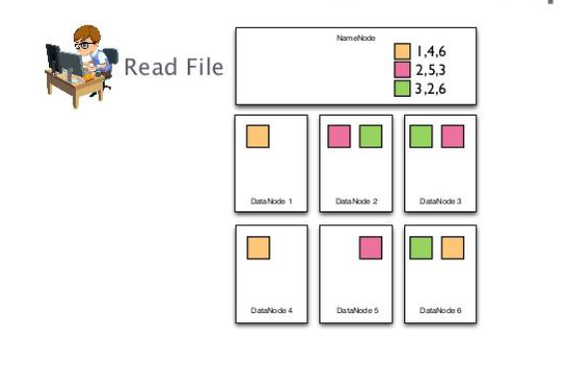
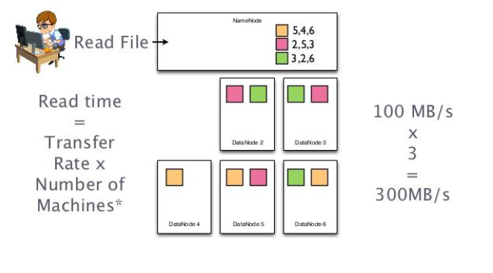

Slide 29
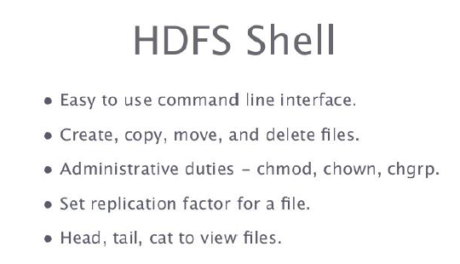

Slide 30

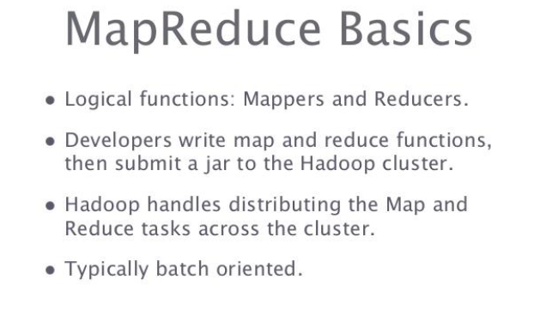

Slide 31
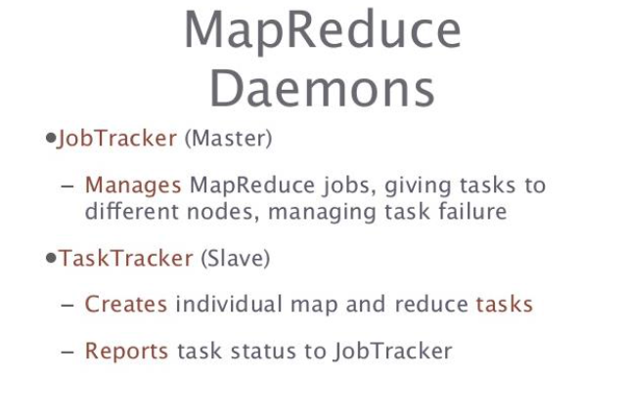

Slide 32
One of each:
Namenode (NN)
Jobtracker (JT)
Set of each per slave machine:
Tasktracker (TT)
Datanode (DN)

Slide 33
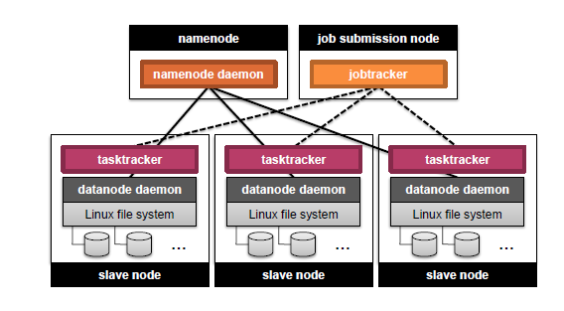

Slide 34
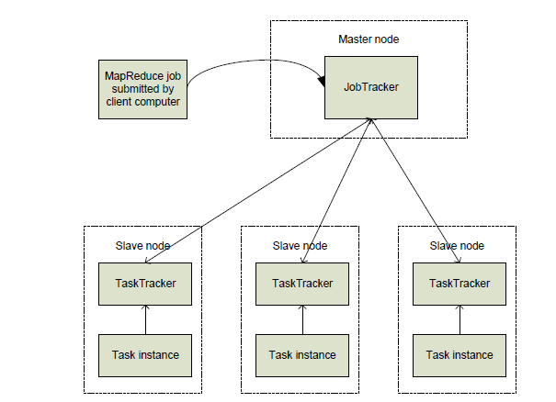

Slide 35
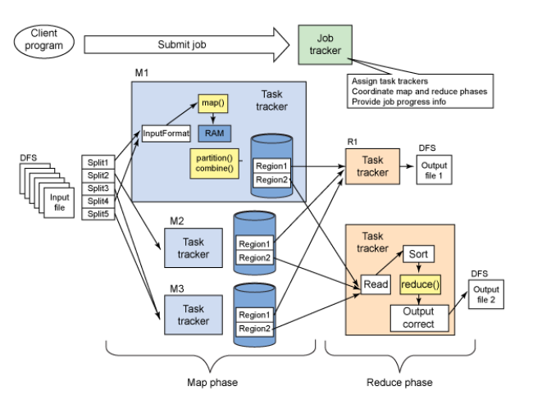

Slide 36
Probably the most complex aspect of MapReduce!
Map side
Map outputs are buffered in memory in a circular buffer
When buffer reaches threshold, contents are “spilled” to disk
Spills merged in a single, partitioned file (sorted within each partition): combiner runs here
Reduce side
First, map outputs are copied over to reducer machine
“Sort” is a multi-pass merge of map outputs (happens in memory and on disk): combiner runs here
Final merge pass goes directly into reducer

Slide 37
Anatomy of the job
MapReduce program in Hadoop = Hadoop job
Jobs are divided into map and reduce tasks
An instance of running a task is called a task attempt
Multiple jobs can be composed into a workflow
Job submission process
Client (i.e., driver program) creates a job, configures it, and submits it to job tracker
JobClient computes input splits (on client end)
Job data (jar, configuration XML) are sent to JobTracker
JobTracker puts job data in shared location, enqueues tasks
TaskTrackers poll for tasks
Off to the races…

Slide 38
Job – A “full program” - an execution of a Mapper and Reducer across a data set
Task – An execution of a Mapper or a Reducer on a slice of data
Task-In-Progress (TIP)
Task Attempt – A particular instance of an attempt to execute a task on a machine .
TaskID represents the immutable and unique identifier for a Map or Reduce Task.
Each TaskID encompasses multiple attempts made to execute the Map or Reduce Task, each of which are uniquely indentified by their TaskAttemptID.

Slide 39
TaskID consists of 3 parts.
First part is the JobID, that this TaskInProgress belongs to.
Second part of the TaskID is either 'm' or 'r' representing whether the task is a map task or a reduce task.
And the third part is the task number.

Slide 40
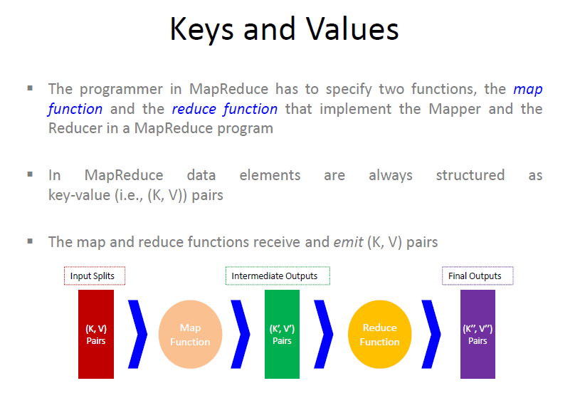

Slide 41
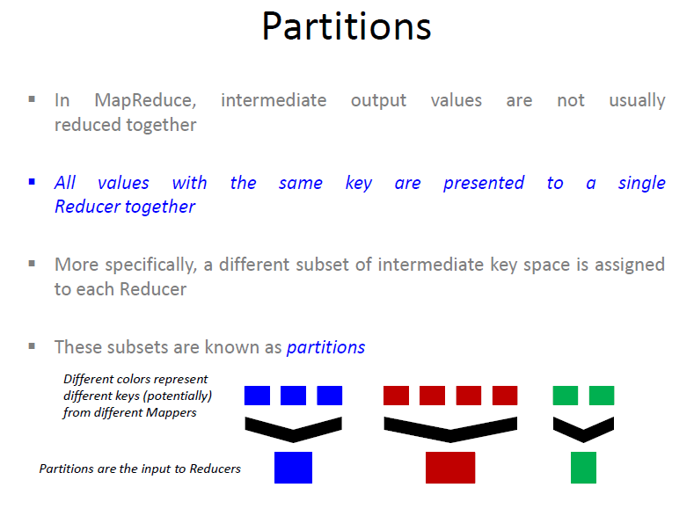

Slide 42
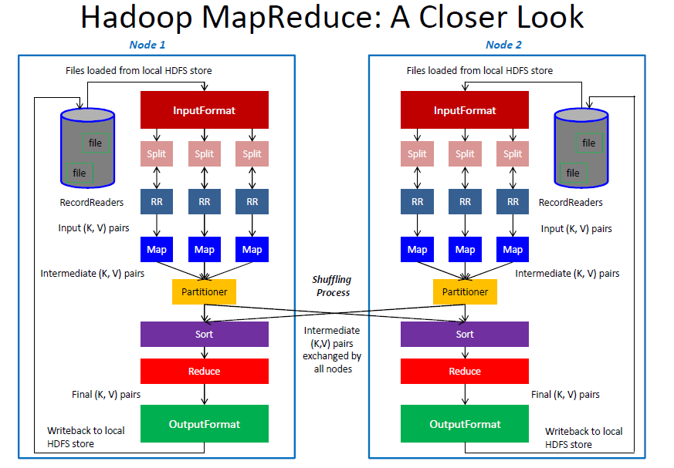

Slide 43
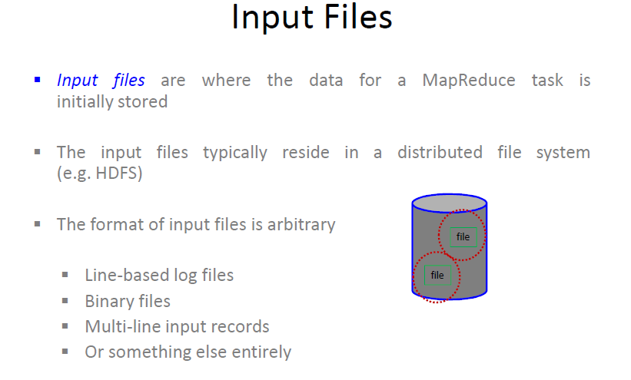

Slide 44
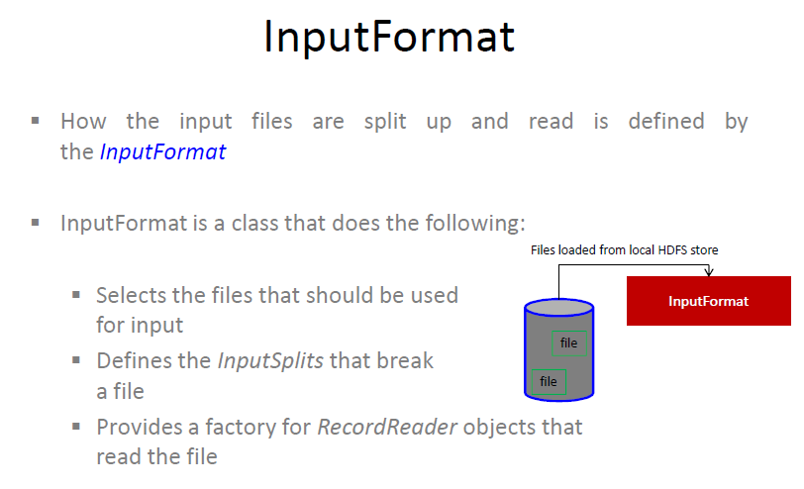

Slide 45
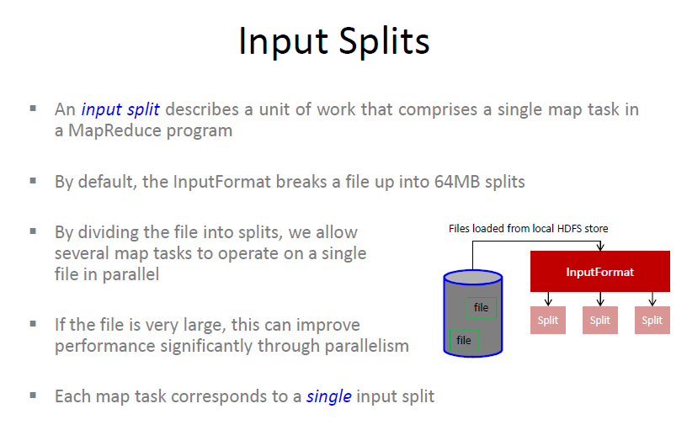

Slide 46
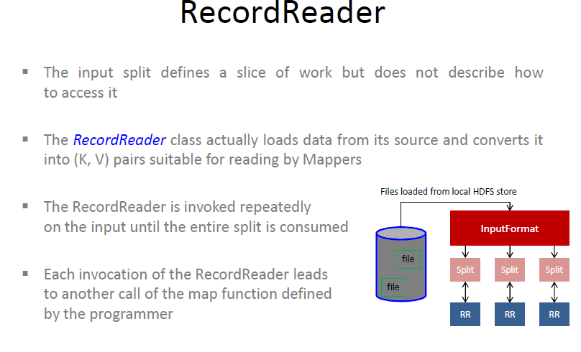

Slide 47
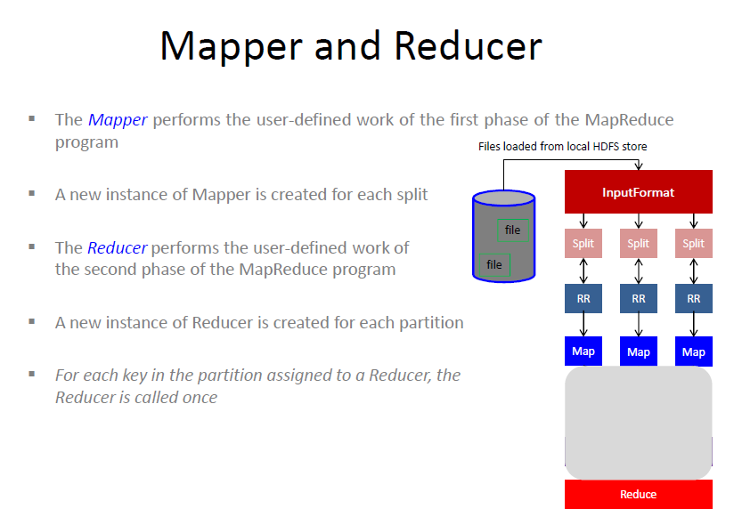

Slide 48
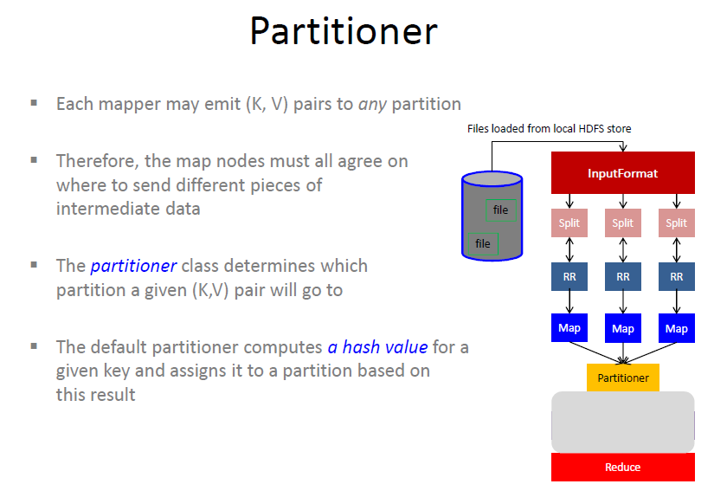

Slide 49
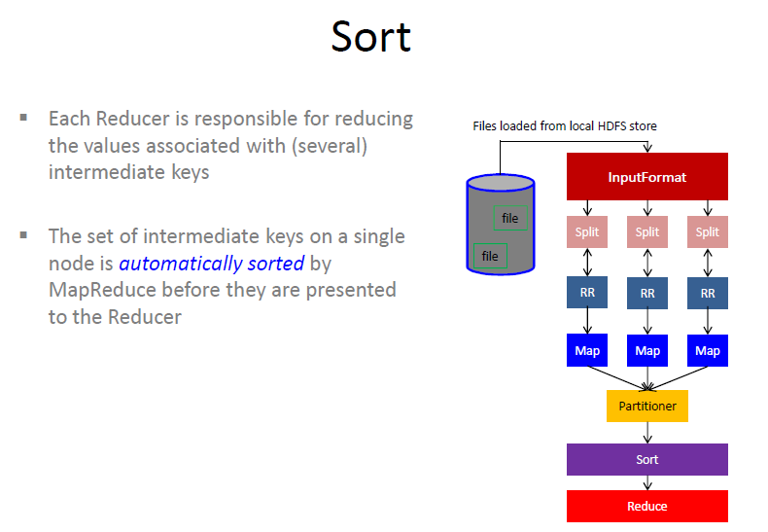

Slide 50
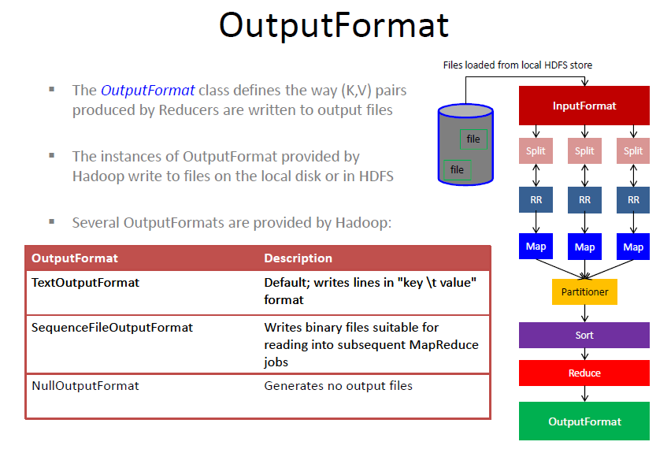

Slide 51
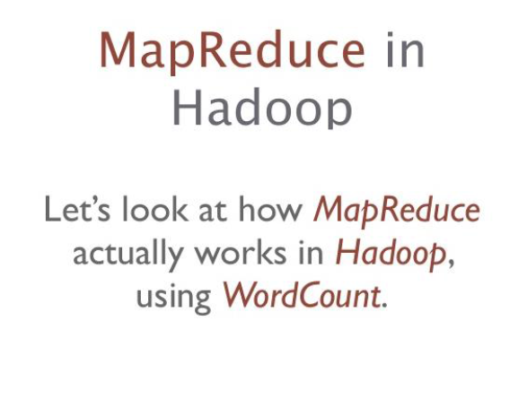

Slide 52
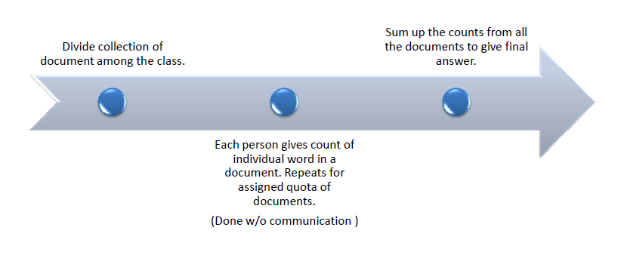
Word count

Slide 53
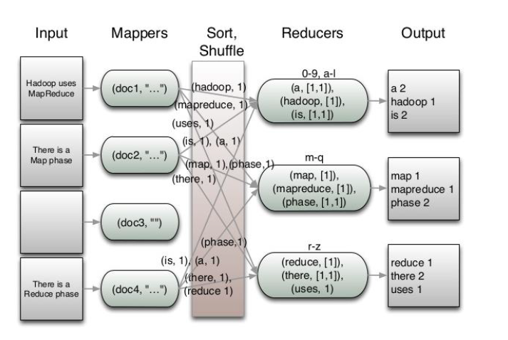

Slide 54
examples.
“THE QUICK BROWN FOX.THE FOX ATE THE MOUSE.HOW NOW BROWN COW”.
“BUS CAR TRAIN.TRAIN PLANE CAR.BUS BUS PLANE”.
“DEER BEAR RIVER.CAR CAR RIVER.DEER CAR BEAR”.

Slide 55
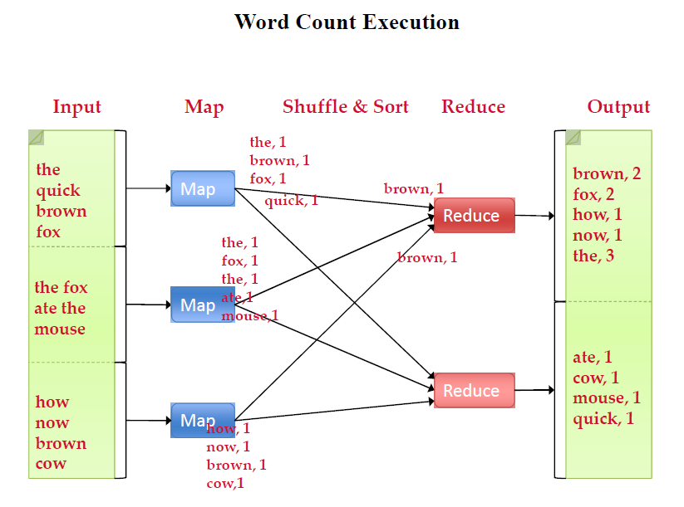

Slide 56
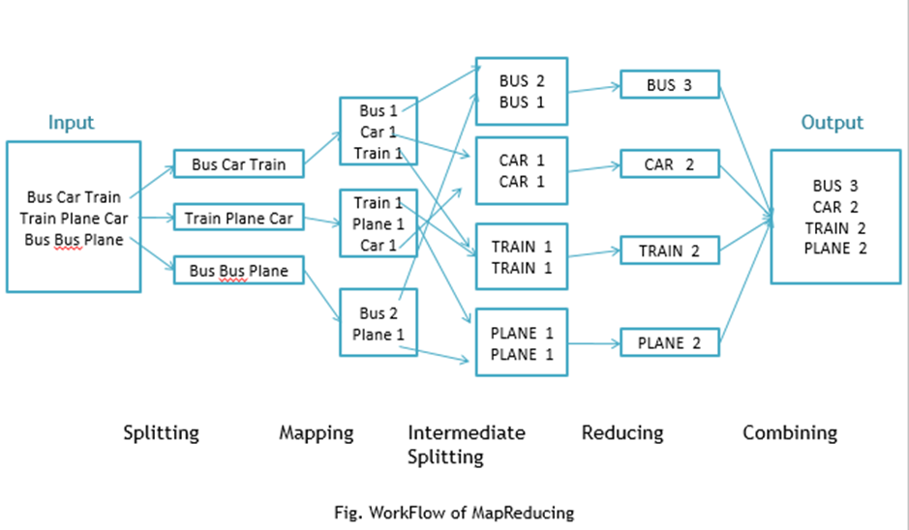

Slide 57
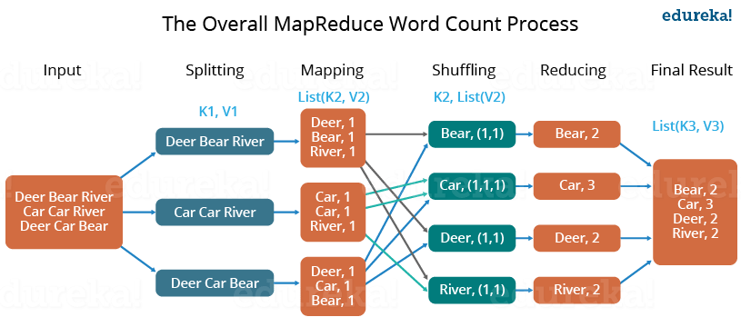

Slide 58

Explain the step by step MapReduce working model for counting the number of words for the following tongue twister.

